Slide 1
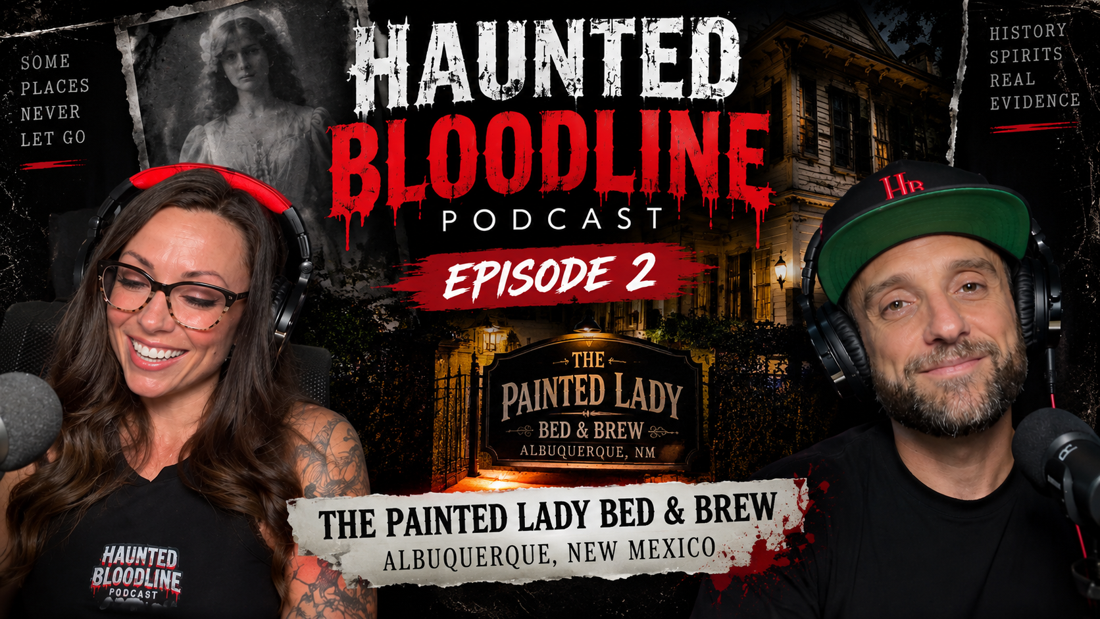
HAUNTED
BLOODLINE
UNSCRIPTED PARANORMAL INVESTIGATION SERIES
Created and hosted by
Jennifer Johnson and Ryan Oswald
The locations are haunted.
The relationship is real.
SERIES PITCH
Notes:
Cover artwork from the Haunted Bloodline brand library.

Slide 2
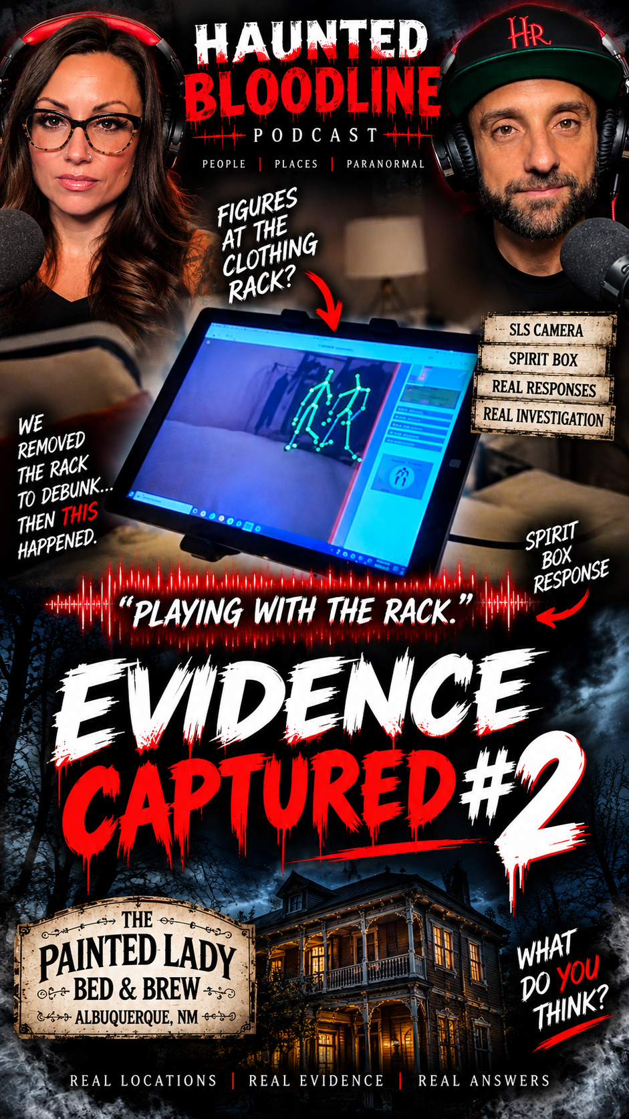
Two siblings walk into the darkness together
A repeatable paranormal format built around real investigations and a real relationship
Brother-and-sister investigators Jennifer Johnson and Ryan Oswald enter locations with disturbing histories and reports of unexplained activity. They combine historical research, modern paranormal equipment and controlled experiments to uncover what may still be lingering behind.
THE SERIES PROMISE
Every episode delivers a documented haunting, an investigation viewers can follow and the chemistry of two hosts who know exactly how to push each other.
SERIES CONCEPT
02

Slide 3
Jennifer Johnson and Ryan Oswald
Their sibling chemistry gives the series a story even before the first unexplained sound
JENNIFER JOHNSON
A veteran digital creator and natural on-camera storyteller. Jennifer leads with curiosity, sharp instincts and the willingness to say exactly what she thinks when an investigation turns.
RYAN OSWALD
Ryan brings grounded humor, direct questions and a steady presence inside the location. His reactions and investigative style naturally counter Jennifer's energy.
LIFETIME OF TRUST
No manufactured partnership. No forced chemistry.
THE HOSTS
03

Slide 4
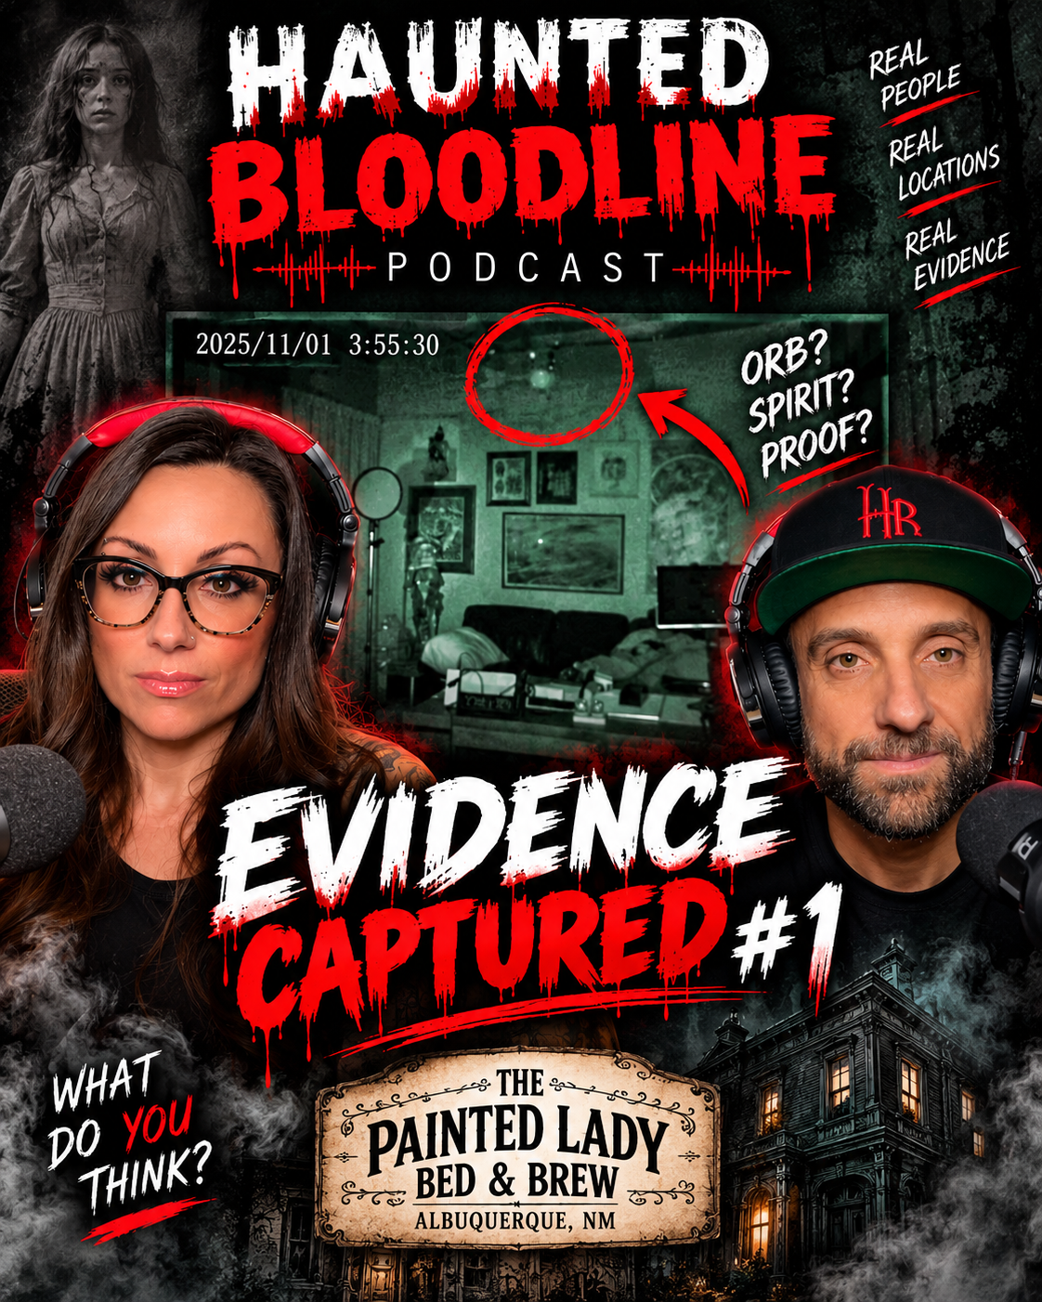
The relationship keeps viewers watching
Paranormal evidence changes by location. Jennifer and Ryan remain the emotional center of every episode.
Real sibling chemistry
They challenge each other, make each other laugh and react differently when a situation becomes uncomfortable.
Credibility over hype
They test claims and attempt to debunk what they encounter. If something has an explanation, the audience hears it.
A show that already exists on camera
The brand, hosts, investigation footage and early audience are already in motion. A partner can develop what viewers can already see.
WHAT THEY HAVEN'T SEEN IS JENNIFER AND RYAN
WHY HAUNTED BLOODLINE
04

Slide 5
A clear investigation engine for 45 to 60 minutes
Each episode moves from the documented story to the evidence, without manufactured scares
01
02
03
04
THE HISTORY
THE CLAIMS
THE NIGHT
THE REVIEW
The location's past, reported activity and the people who experienced it.
Jennifer and Ryan identify what they can test during the investigation.
Multiple methods, controlled experiments and genuine reactions inside the location.
They analyze the audio, video and instrument data, then separate explanations from open questions.
Recurring elements
Historical voices Host banter Equipment experiments Evidence review
EPISODE FORMAT
05

Slide 6
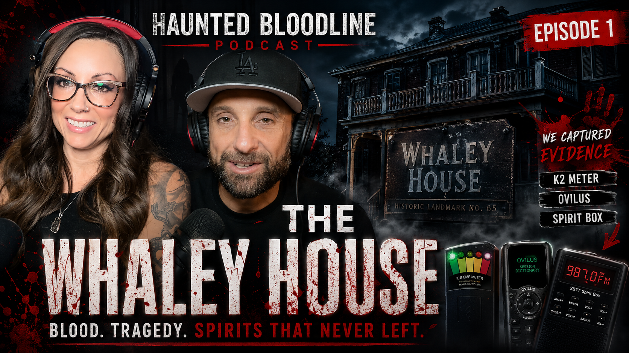
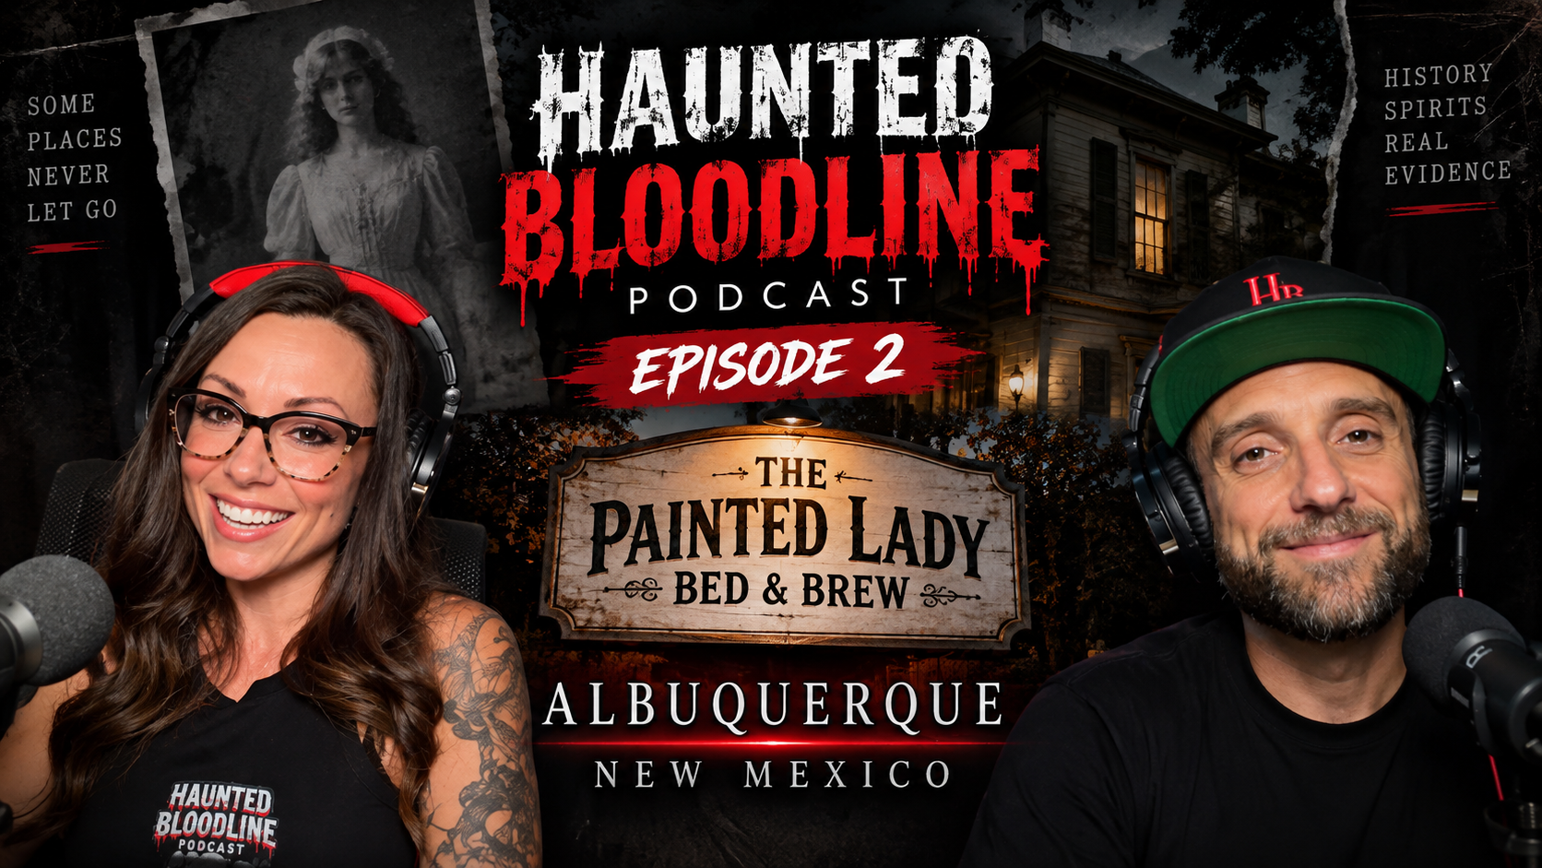
The cameras are already rolling
Two filmed investigations show the hosts, visual identity and evidence-driven format
THE WHALEY HOUSE
THE PAINTED LADY BED & BREW
San Diego, California
Albuquerque, New Mexico
A landmark haunting investigated with spirit-box sessions, EMF monitoring and on-location documentation.
The team captured unexplained audio, direct spirit-box responses and unusual SLS activity during the investigation.
PROOF OF CONCEPT
06

Slide 7
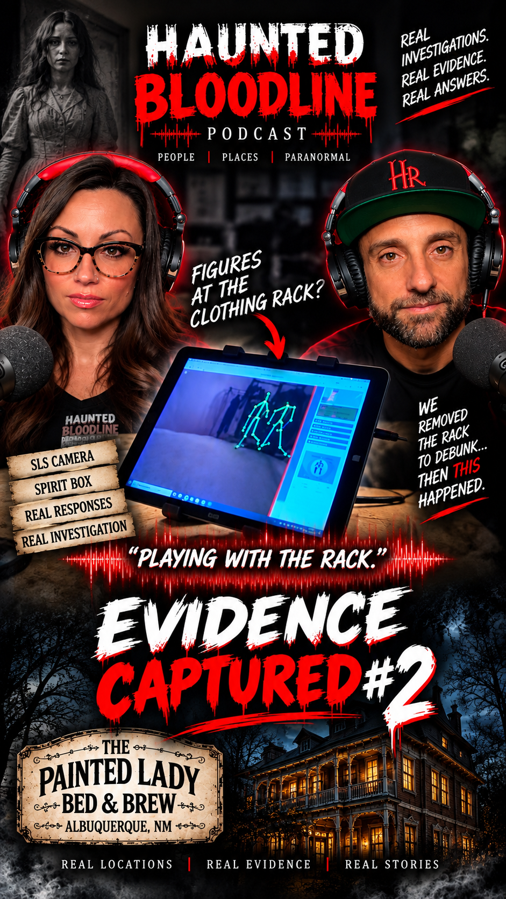
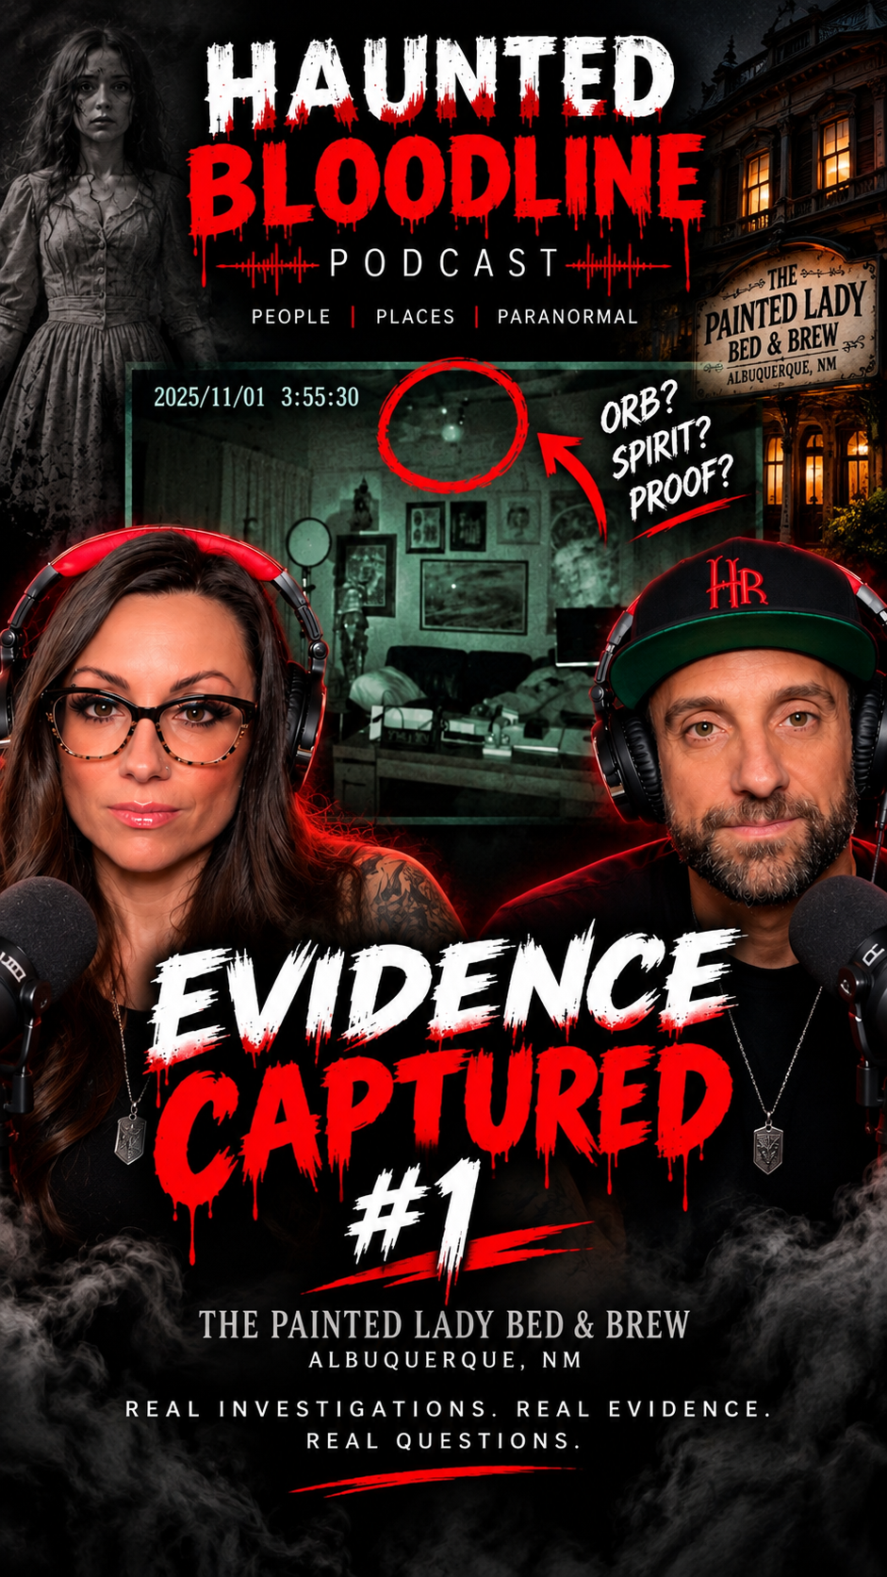
An immediate platform for discovery
Jennifer brings an established audience while Haunted Bloodline builds its own paranormal community
280K+
INSTAGRAM FOLLOWERS
An existing channel for trailers, behind-the-scenes content and audience conversion.
HAUNTED BLOODLINE PODCAST
The podcast and social channels extend each investigation beyond the episode and give fans a place to follow the evidence.
BUILT-IN AUDIENCE
07

Slide 8
The American Southwest gives the series a strong first world
Sample territories only. Individual location access would be secured during development.
LAS VEGAS
VIRGINIA CITY
GOLDFIELD + TONOPAH
Casino legends, historic neighborhoods and the unseen stories behind a city built on reinvention.
Mining history, preserved buildings and generations of reported activity.
Remote desert towns where isolation and history create a naturally cinematic setting.
SAN DIEGO
NEW MEXICO
BEYOND THE SOUTHWEST
Historic properties and maritime stories that expand the world beyond Nevada.
Adobe landmarks, frontier history and the locations where Haunted Bloodline began filming.
The format can travel anywhere a documented story, compelling access and a credible investigation intersect.
LAS VEGAS BASE. NATIONAL FORMAT.
SEASON ONE STORY TERRITORY
08

Slide 9
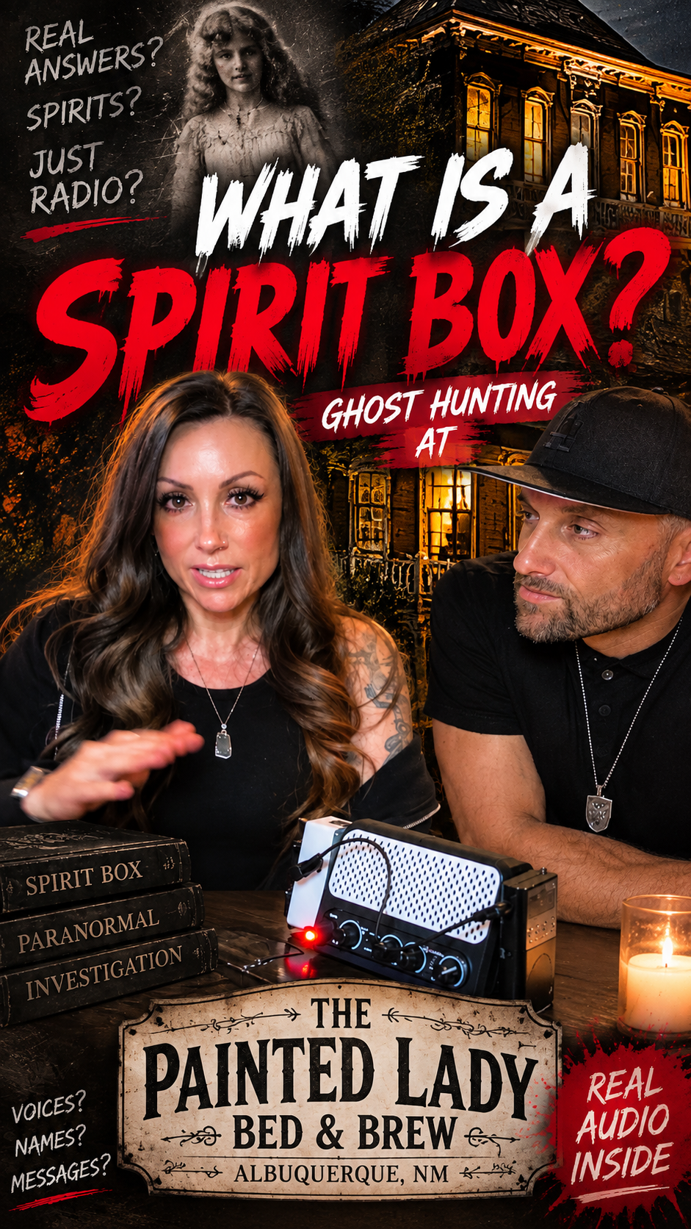
Cinematic enough for television, honest enough to trust
The show protects the credibility of the investigation while giving the audience a strong visual experience
VISUAL LANGUAGE
Dark, polished location photography paired with readable evidence graphics and restrained reenactment when history needs context.
INVESTIGATION COVERAGE
Clean host audio, establishing footage, multiple cameras and isolated equipment feeds that preserve what happened in the room.
EVIDENCE STANDARD
The episode shows the attempt to debunk. Unresolved moments stay unresolved instead of becoming forced conclusions.
DIGITAL EXTENSIONS
Short evidence cuts, host reactions and post-episode discussion feed the social audience without replacing the full story.
PRODUCTION VISION
09

Slide 10

SEEKING THE RIGHT
PRODUCTION PARTNER
Jennifer Johnson and Ryan Oswald are seeking an experienced unscripted television partner to develop Haunted Bloodline, shape the series package and position it for network or streaming buyers.
THE BRAND, HOSTS, INVESTIGATIONS AND ORIGINAL FOOTAGE ARE ALREADY IN PLACE.
JENNIFER JOHNSON + RYAN OSWALD
BloodlineParanormal.com
Creators and Hosts, Haunted Bloodline
HauntedBloodlinePodcast@gmail.com
UNSCRIPTED PARANORMAL INVESTIGATION SERIES

